Slide 1
Cousining:
A Process?

Slide 2
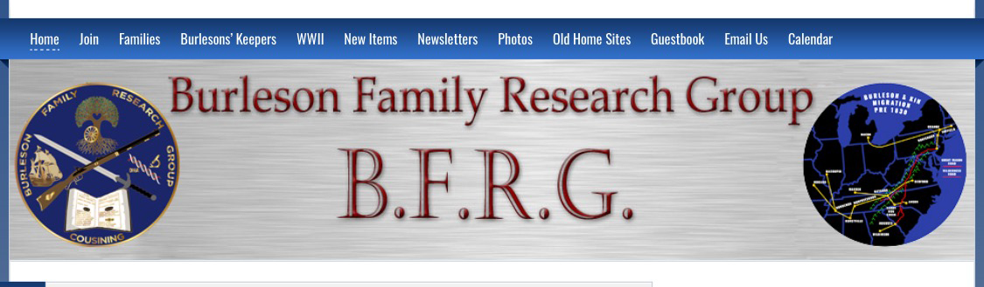
Welcome to this presentation about how and why we’ve chosen this path for our genealogy forum.

Slide 3
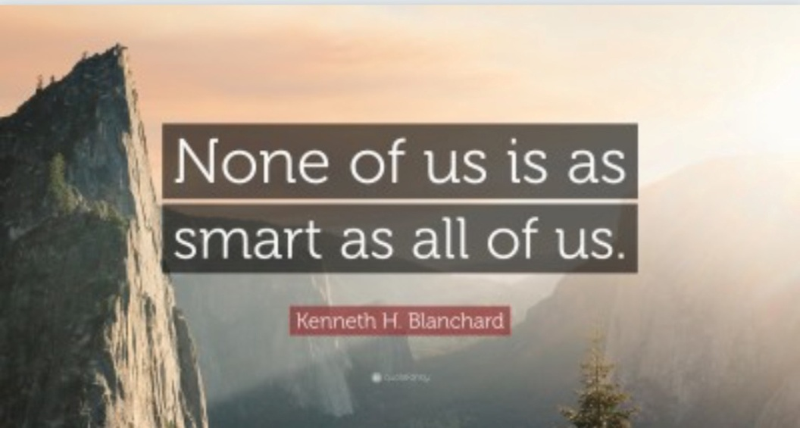
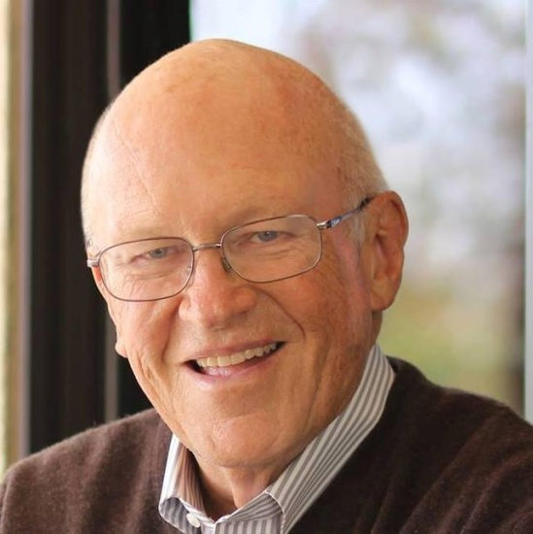
Let’s start with some driving principles:

Slide 4

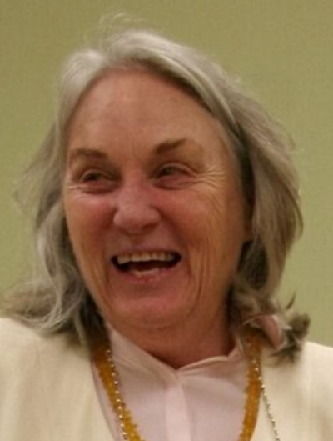

Greater than average communication:

Slide 5



Take a critical eye to history/
Job task analysis of
VERBS-Val Lubans

Slide 6
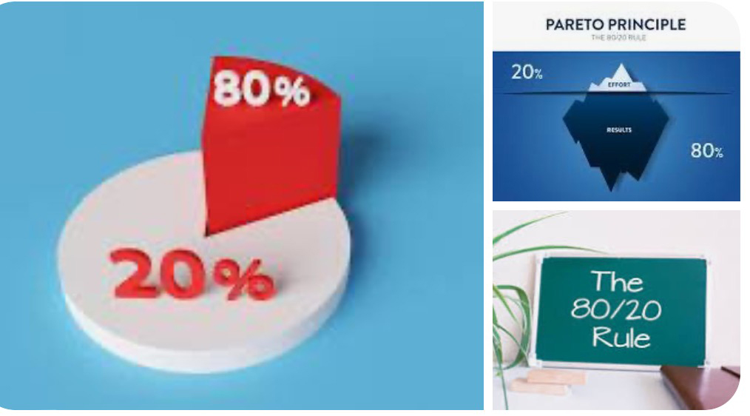
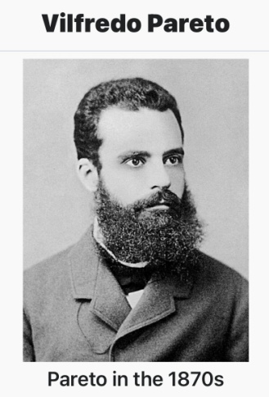
Seek Consensus/Proof

Slide 7

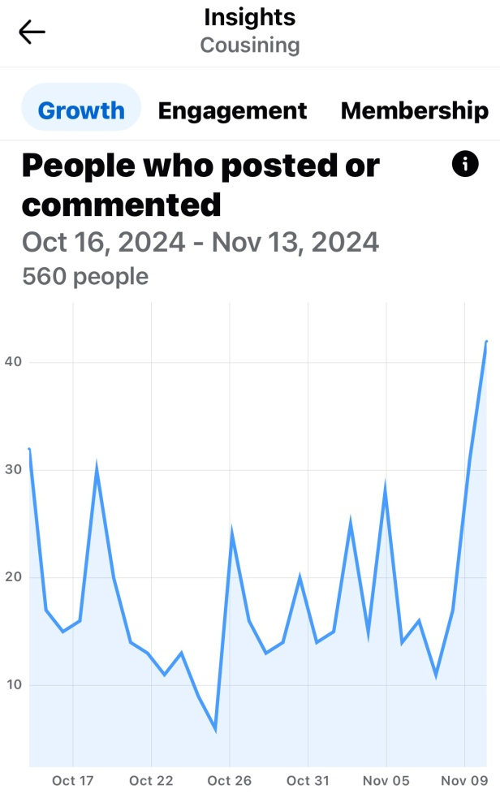
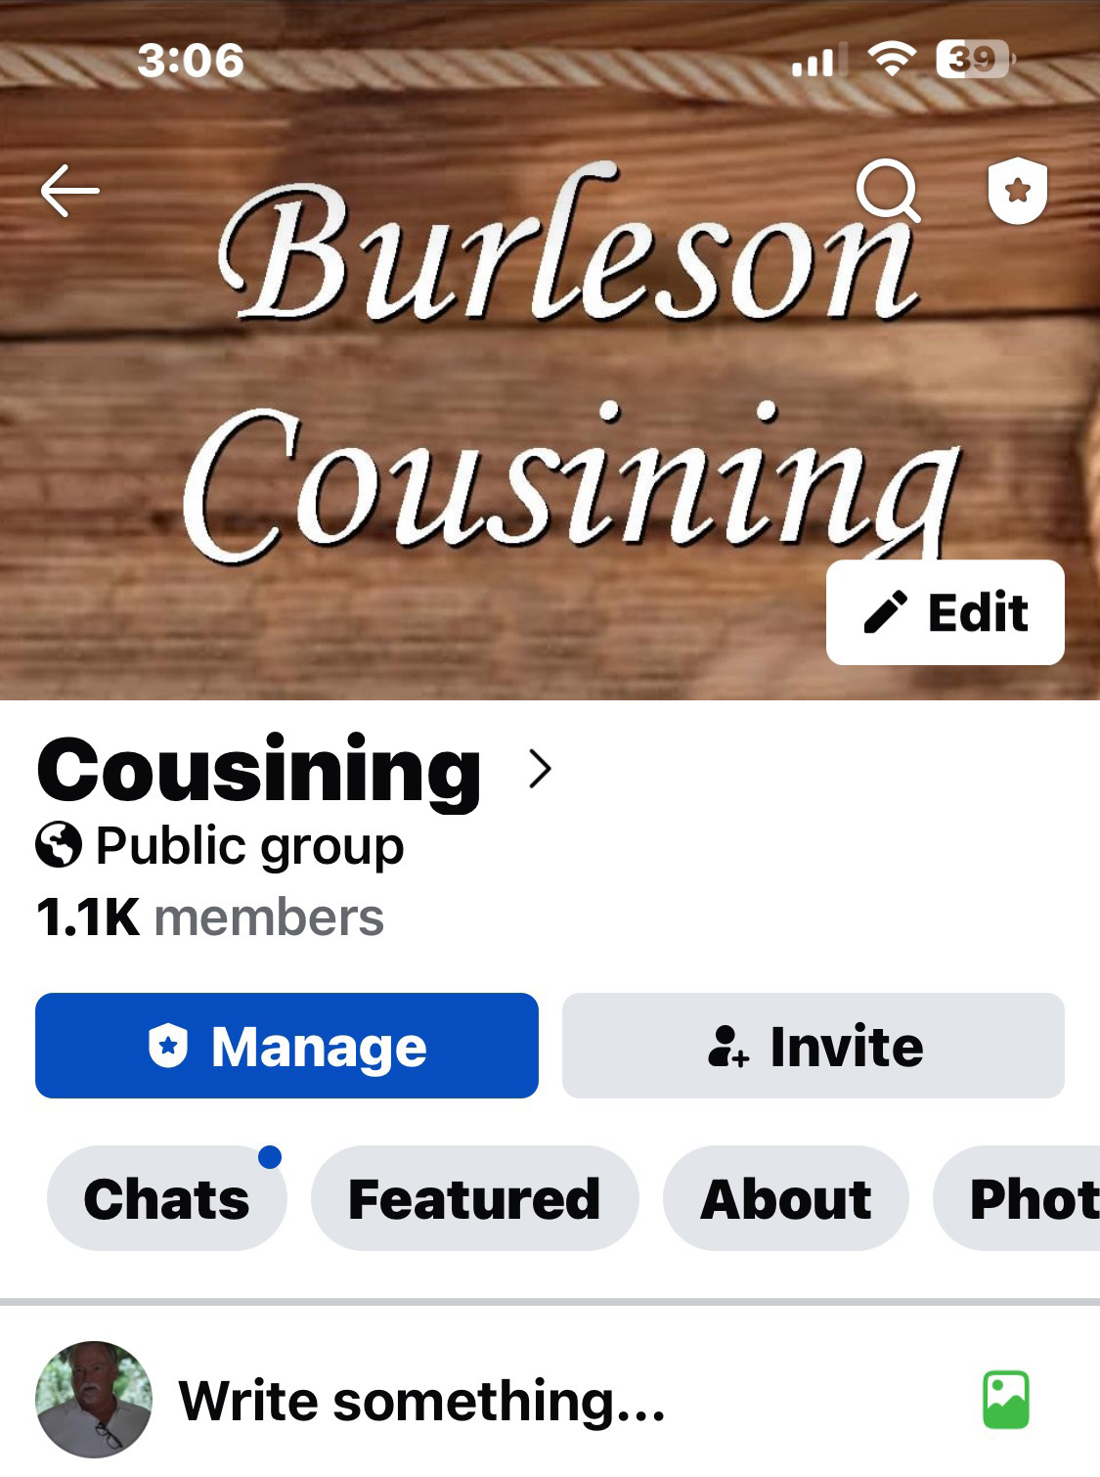
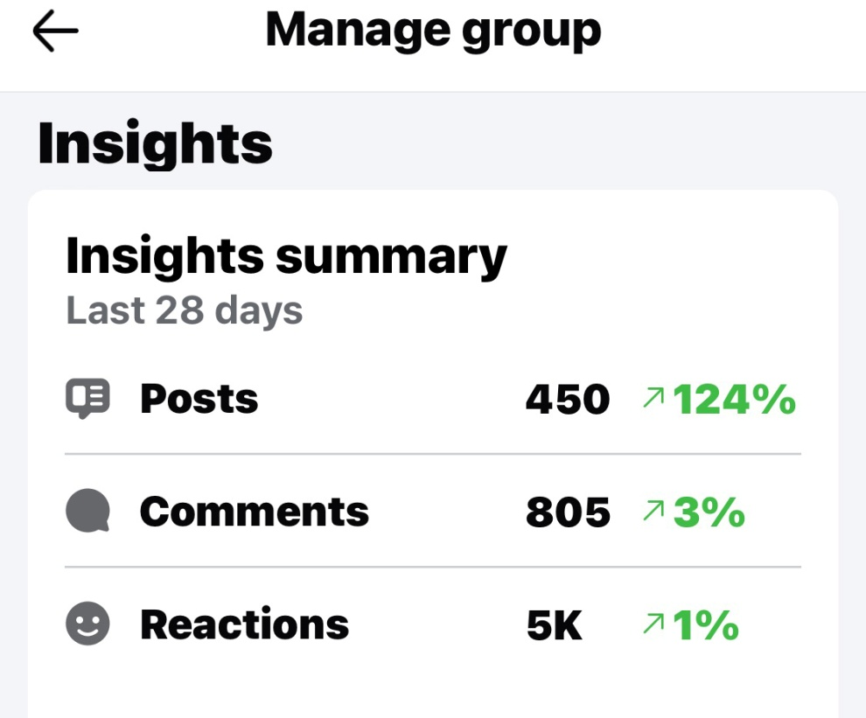
The Feeder:
Why Facebook?

Slide 8
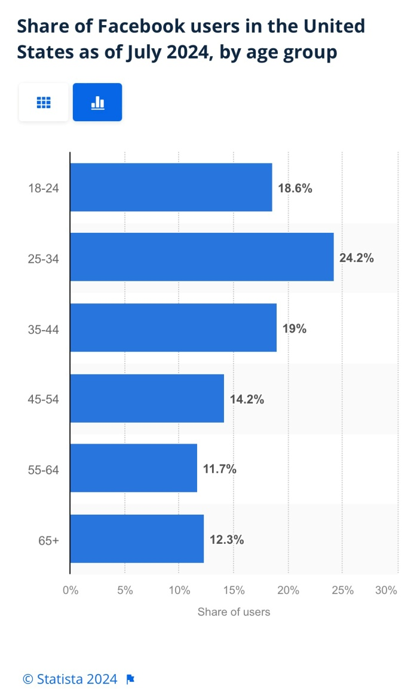
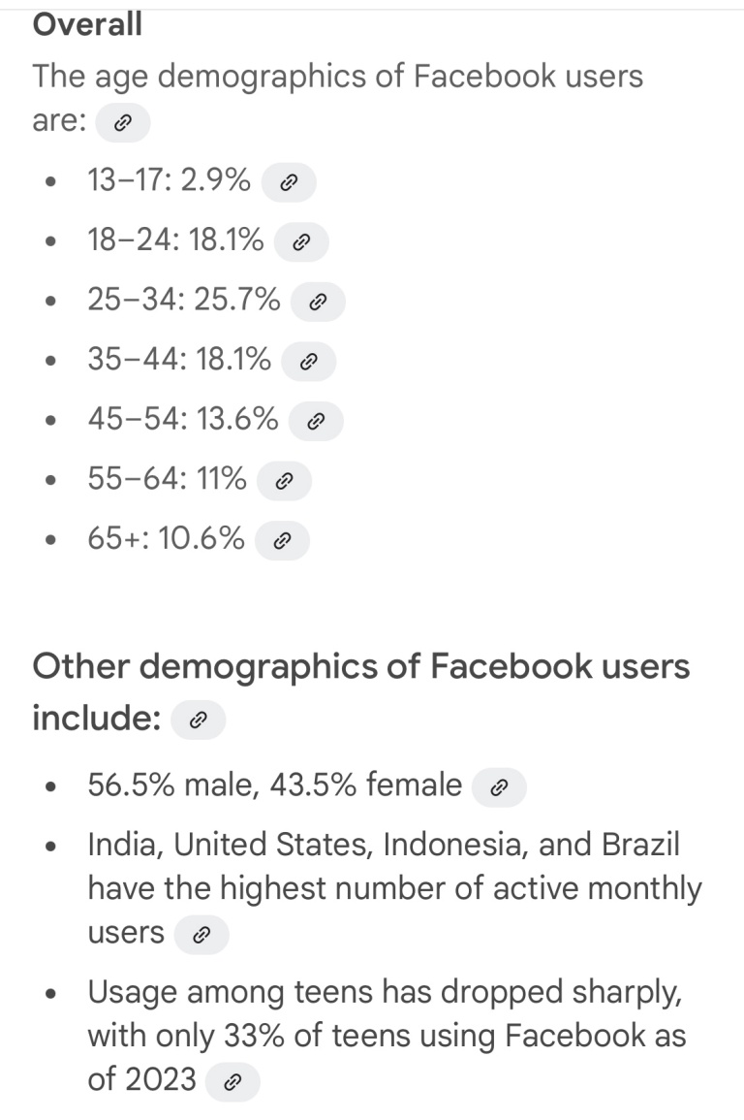
The Feeder:
Why Facebook?
Keep it clean, apolitical, uncriticizing and lively. Vary history, meet cousins, family milestones, how do you relate, this day in history, chatter and humor. The quiet objective is discovery of
new cousins- their lines. Promote submission of lines and DNA. PICTURES!

Slide 9
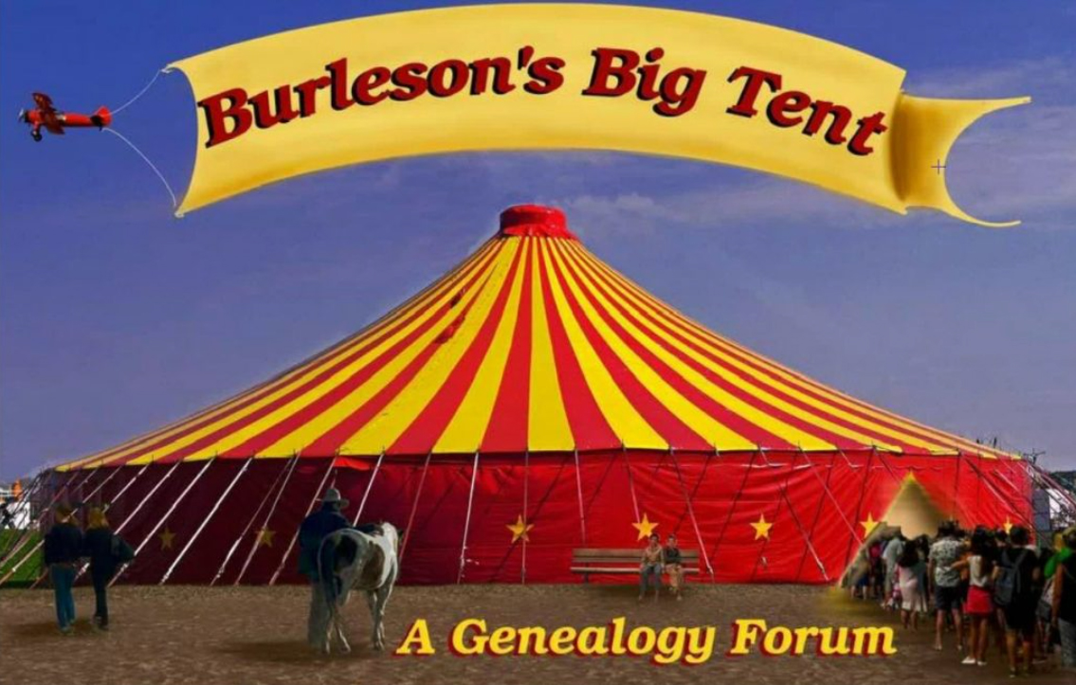
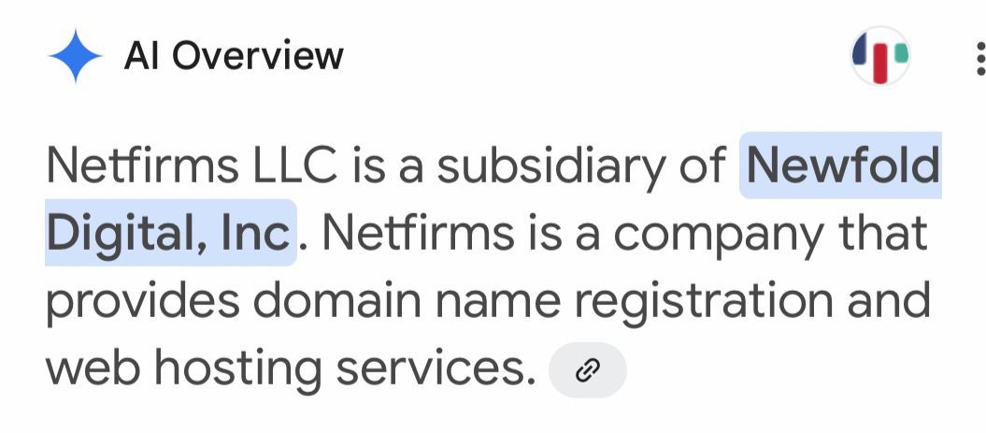
What would you do with an UNLIMITED DATA STORAGE repository?
We acquired three of five domains on Netfirms

Slide 10

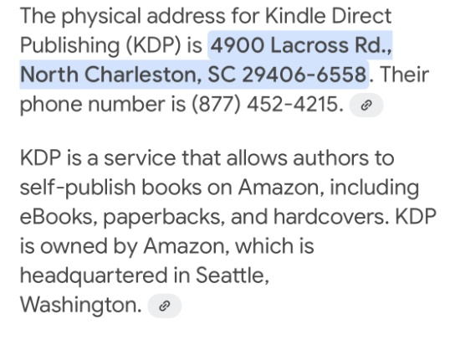
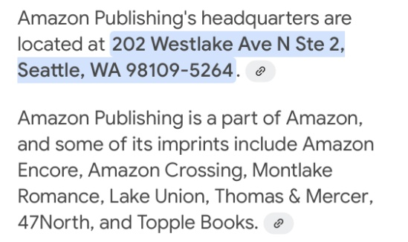
Burleson Heritage Publishing
Our books begin as word documents submitted in single spaced, twelve point sized, Garamond font on pages margined as 1”/1”/1”/1&1/4” (mirroring).
Authors agree to zero pay.
Drafts are applied with images by editor then forwarded to WordPress > Kindle Direct Press…
if physical copies are needed, they’re print on demand … marketed via Amazon.
Cover art created at editor level.
Author/ Editor/ Publisher merit about a 70% discount. Full price for Amazon
distribution is set by author/ publisher with about $4.00/ copy benefitting BFRG.

Slide 11
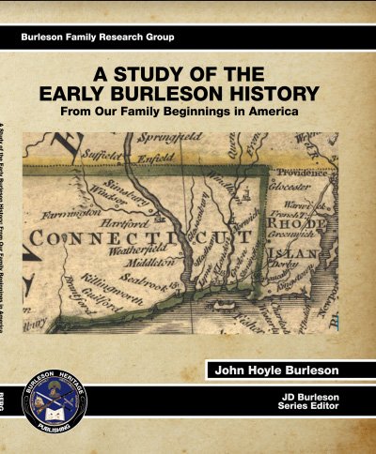
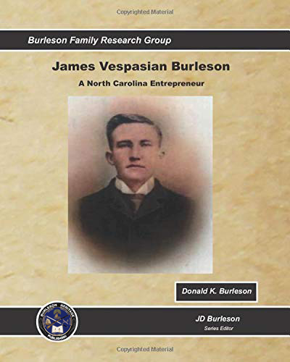
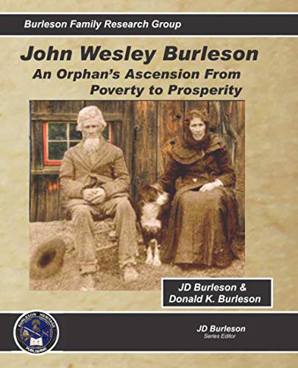
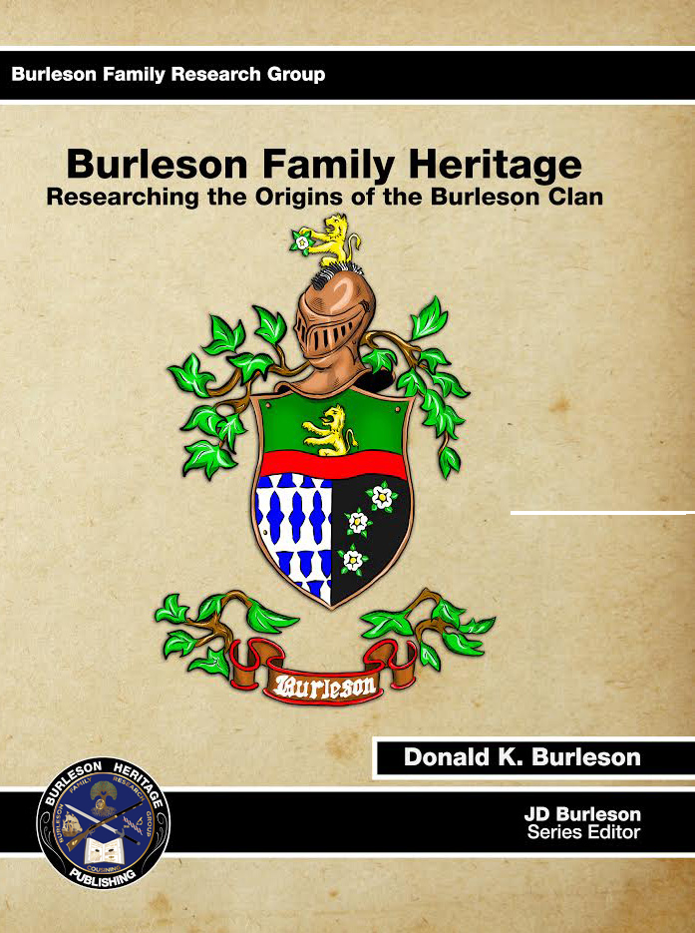
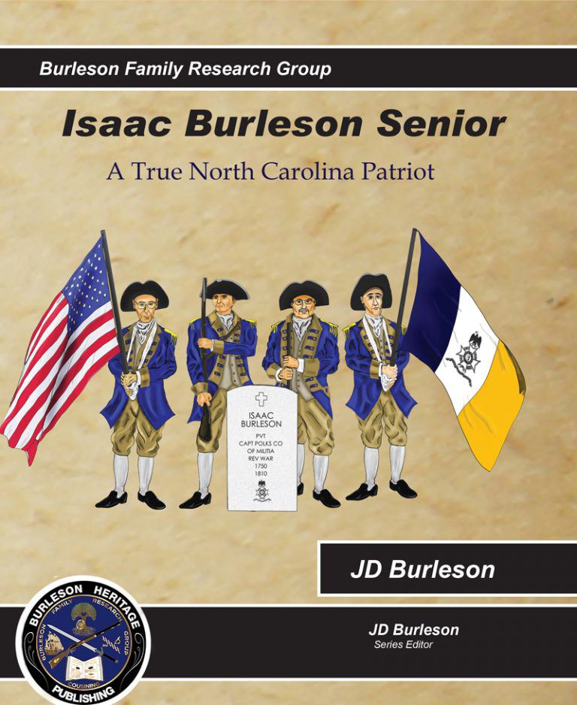
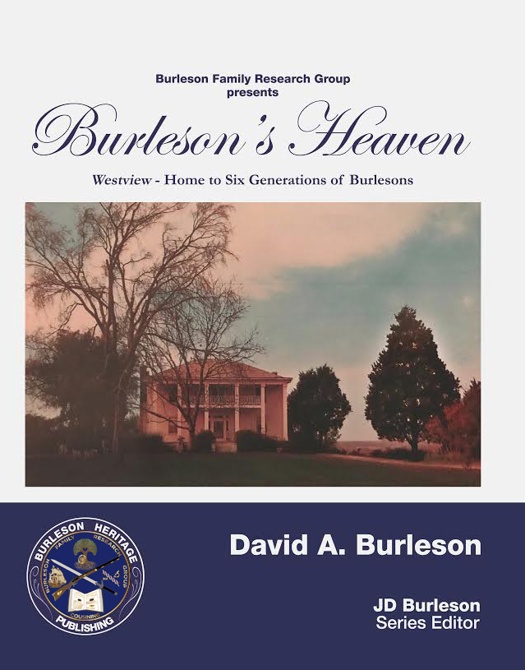
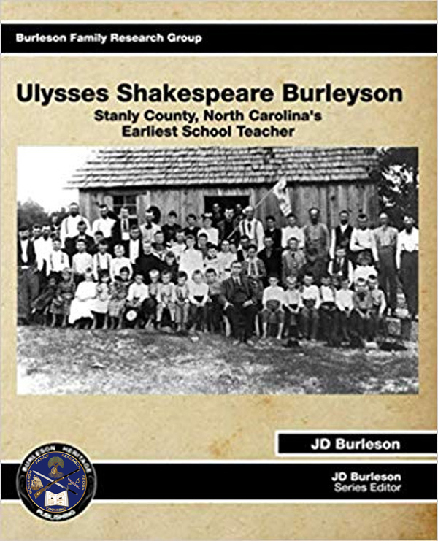
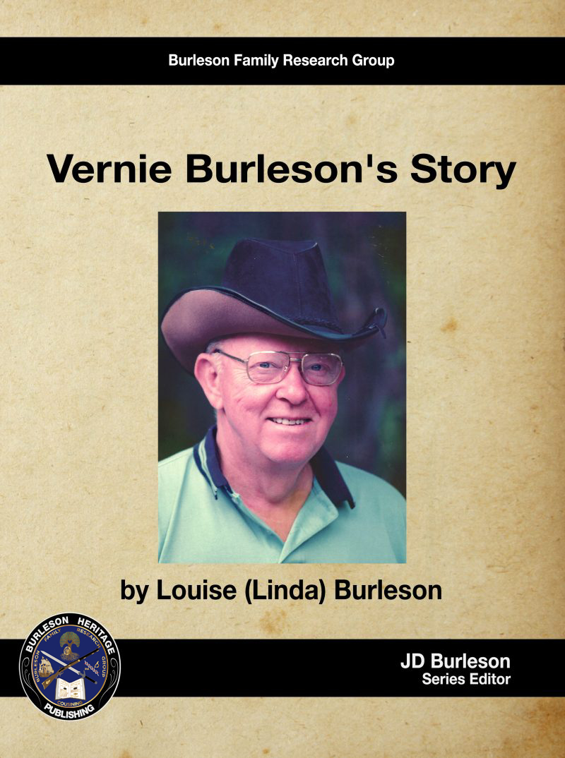
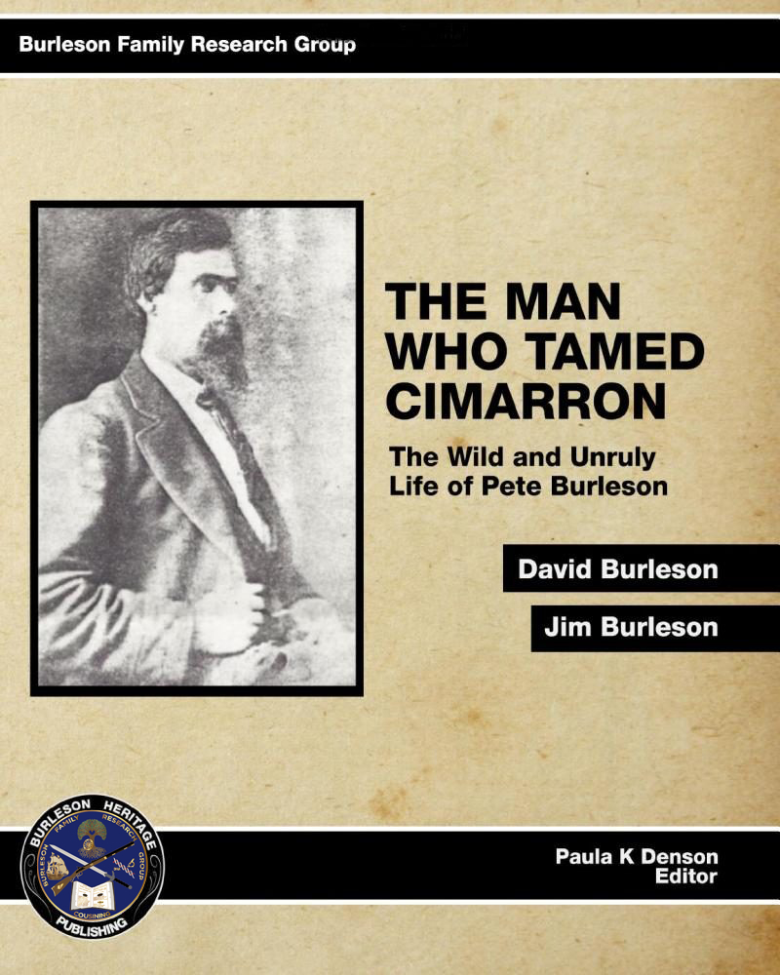
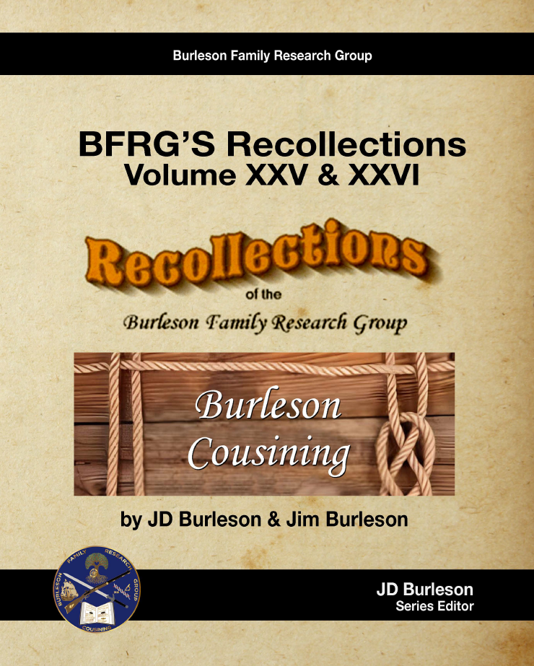
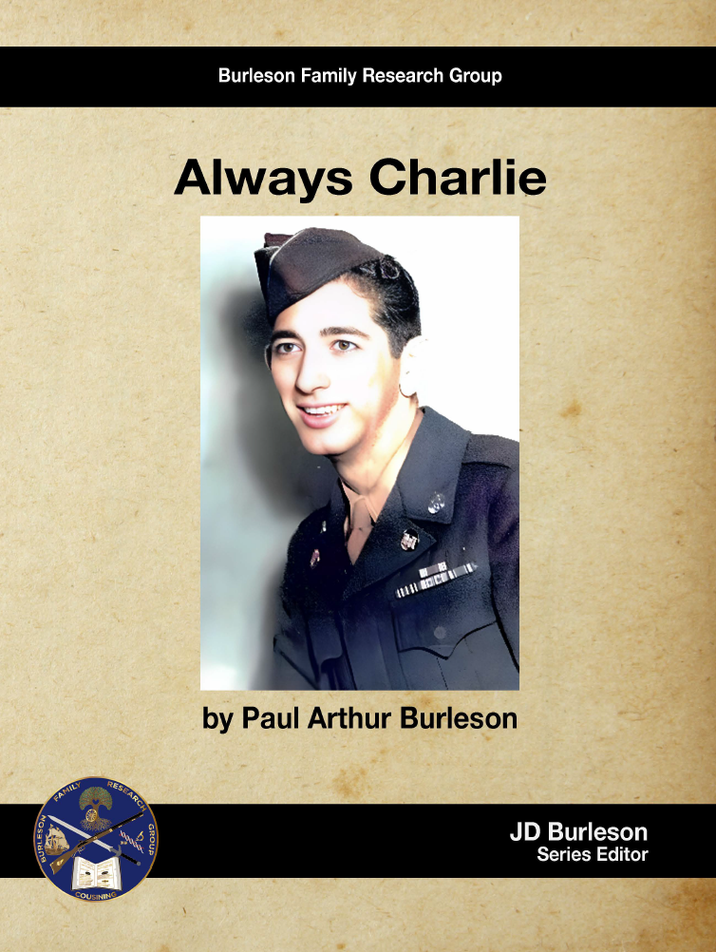
Burleson Heritage Publishing

Slide 12
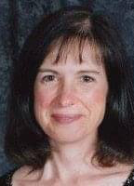
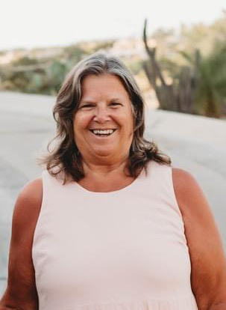
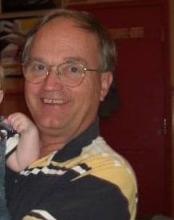


The Burleson DNA
Projects

Slide 13
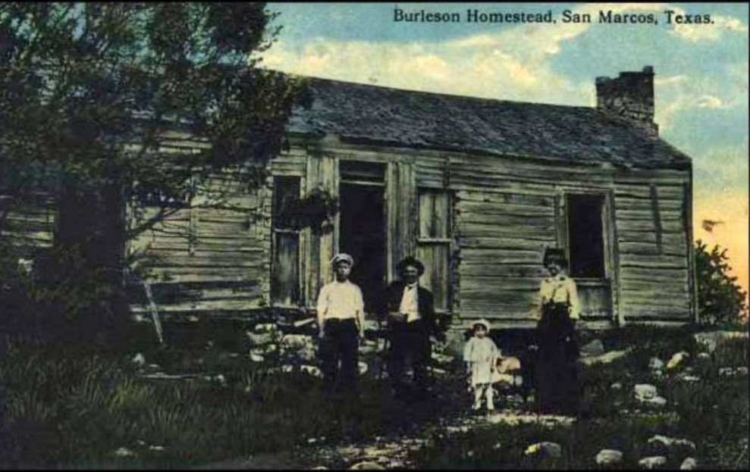
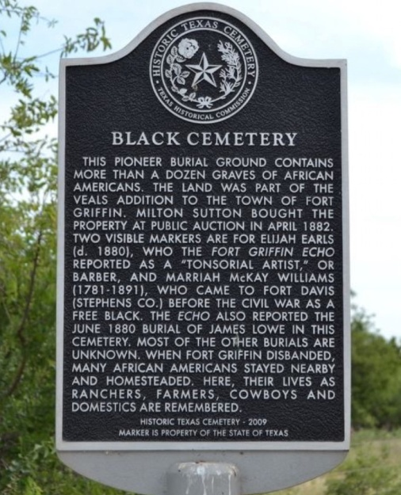
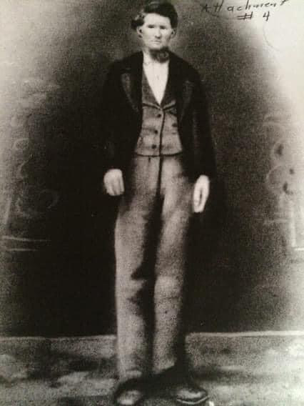
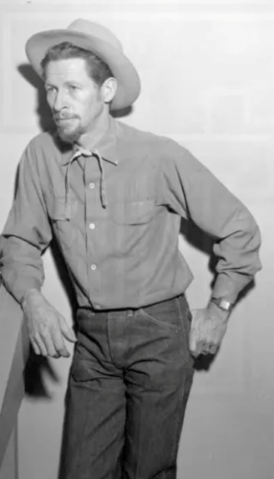
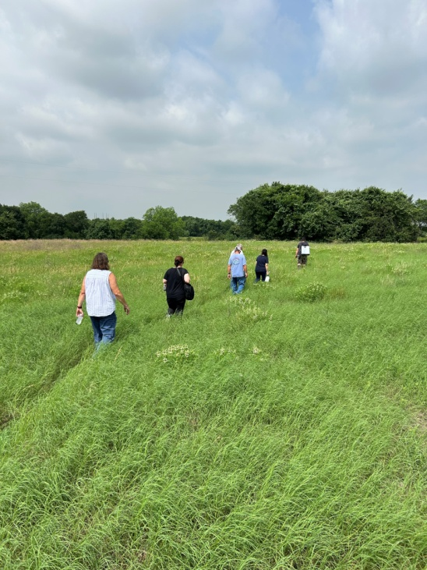
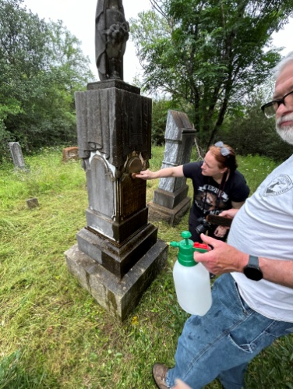
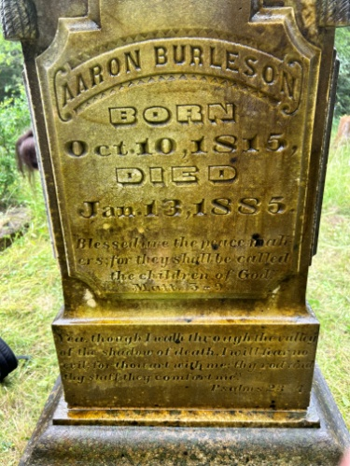
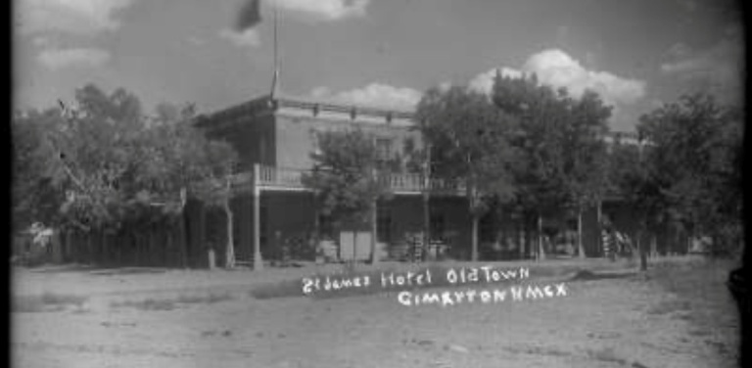
Activism

Slide 14
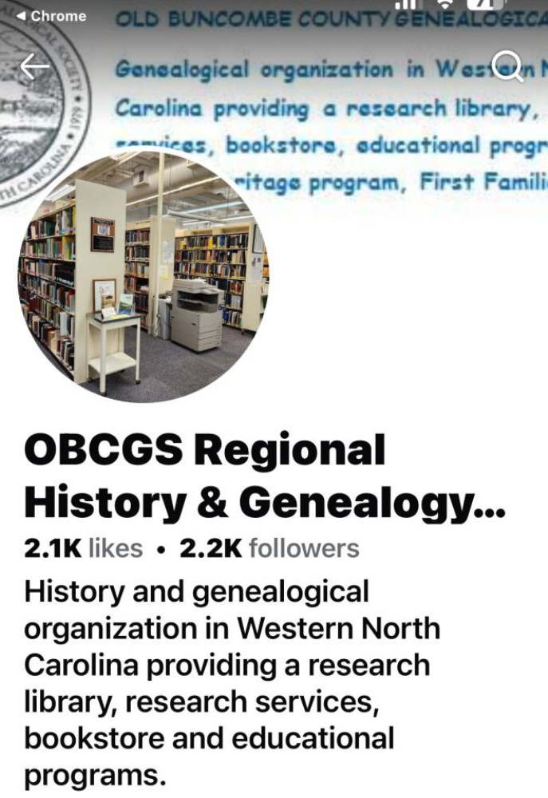
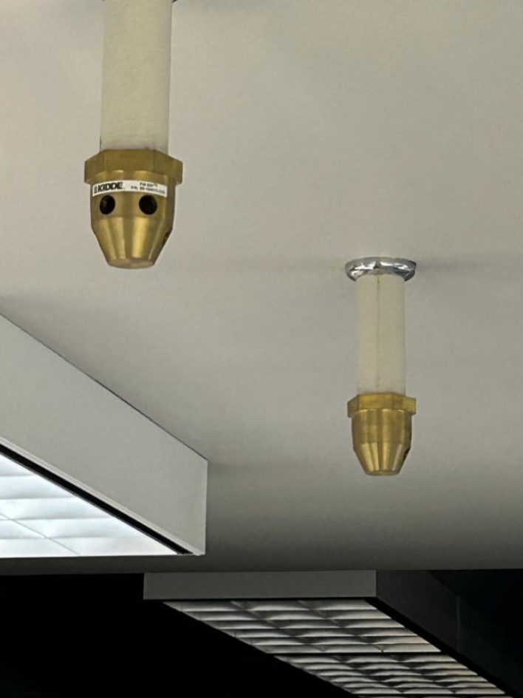
Permanent Repository
Burleson Family Research Group has negotiated perpetual storage of any and all data storage behind the firewall of the Old Buncombe County Genealogical Society in Asheville, North Carolina. We also successfully acquired unlimited data and physical item storage in the new climate-controlled Daughters
of the Republic of Texas Library in San Antonio.

Slide 15
Field Trips versus Family Reunion
There are ten Burleson family associations, eight in Texas alone. BFRG is happy to send representative(s) to local reunions for pictures, documents, etc.
Our strategy is to send researchers to historic Burleson sites to meet larger groups of cousins. Costs are controlled, complaints are minimized, the documentation we need is there, genealogical historians are on site and we get to walk in our ancestors’ footsteps.
Seventy-five cousins met us along field trip one: Virginia > North Carolina >Tennessee.
Eighty—seven cousins met us on field trip two: across the width of Texas.
No BFRG funds were expended on these field trips.
Field trip three? April 29-May 6 we’ll be in Old Saybrook, Suffield and Hartford, Connecticut- origin of Burlesons in America.

Slide 16
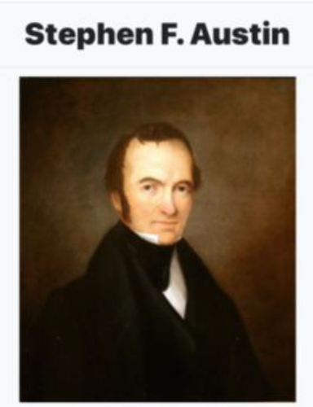
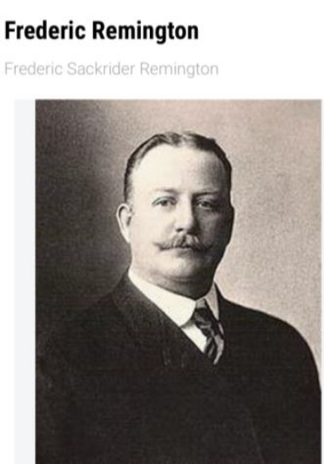
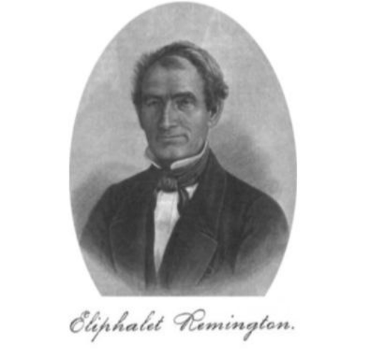
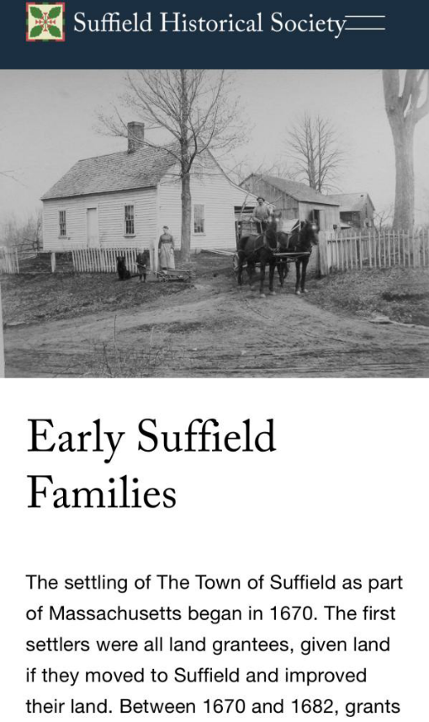
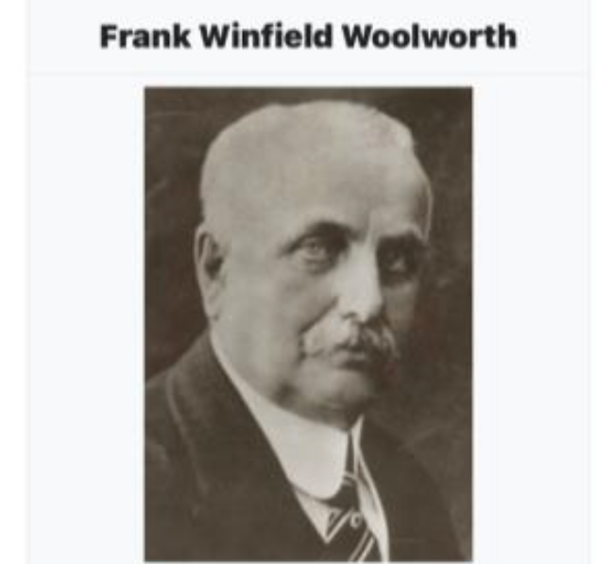
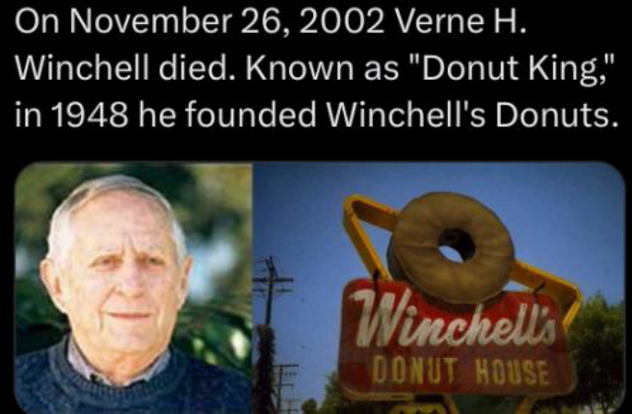
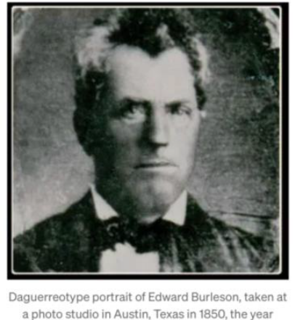
Original Proprietors of Suffield

Slide 17
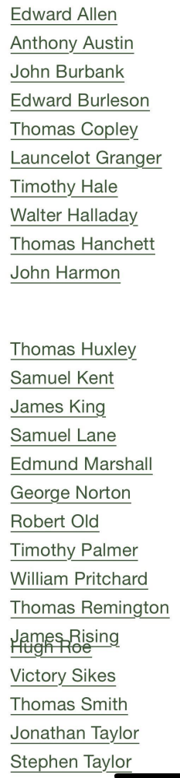
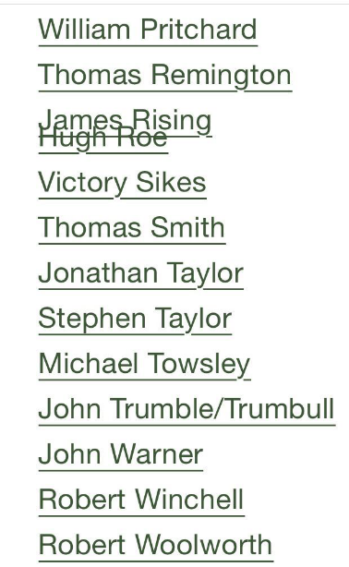
Original Proprietors of Suffield

Slide 18
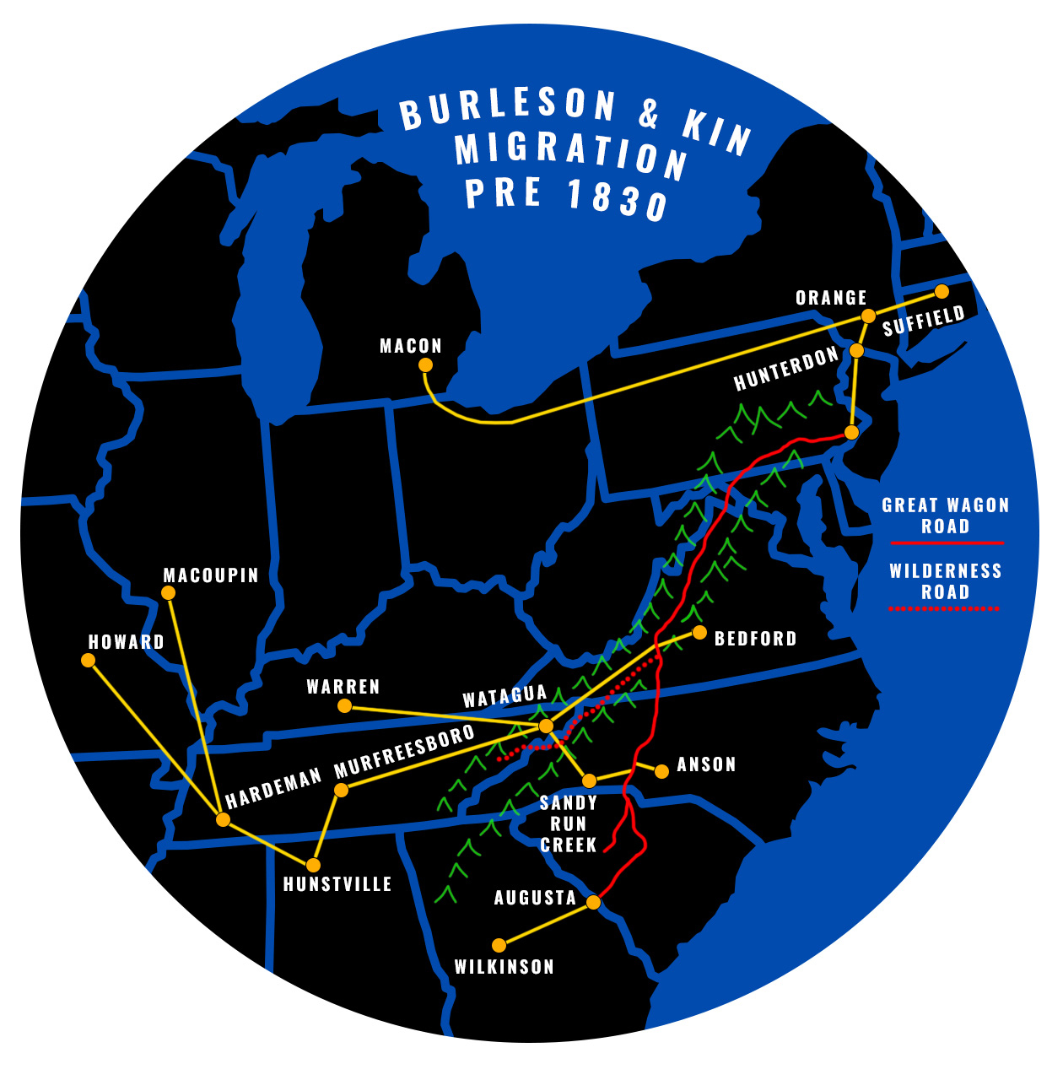
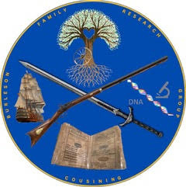
The Coin and Legacy

